Slide 1

History of Genome sequencing
9-9-24

Slide 2
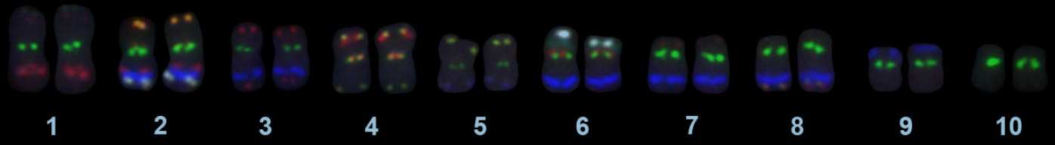
Genome assembly
Maize genome karyotype, 10 pairs of chromosomes (2x=2n=10
The maize genome is 2.4 Gb, or 2.4 billion base pairs
The maize genome is ~88% repetitive elements, with some having tens of thousands of near identical sequences
Each maize chromosome is larger than the whole Arabidopsis genome
How do we sequence this thing?

Slide 3
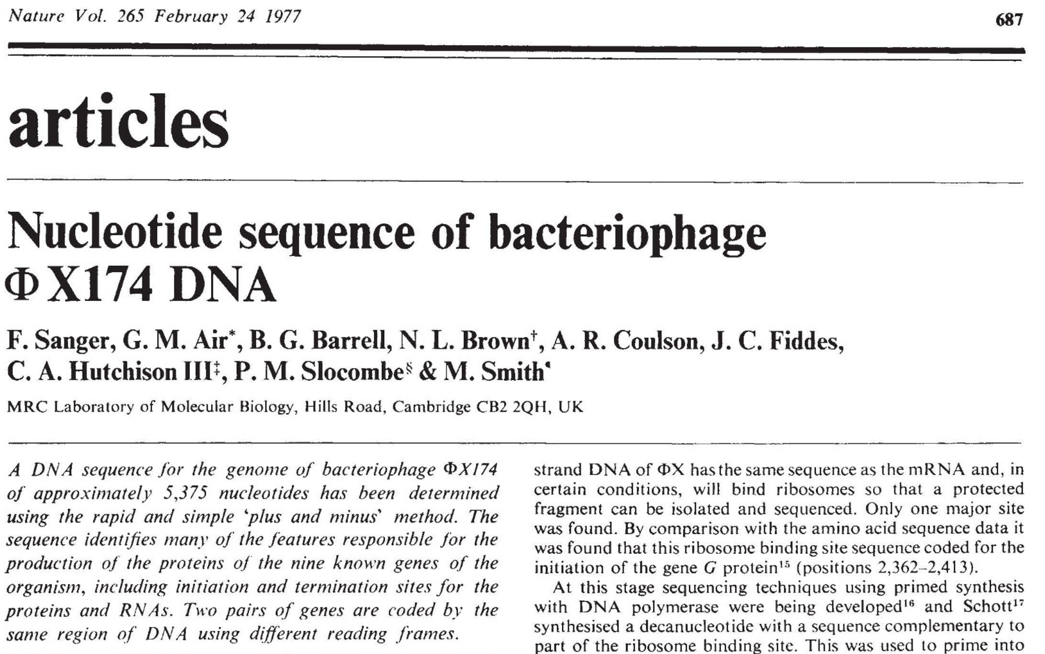
A trip back in time (1977-~2000) Sanger sequencing
What was the first genome to be sequenced?

Slide 4
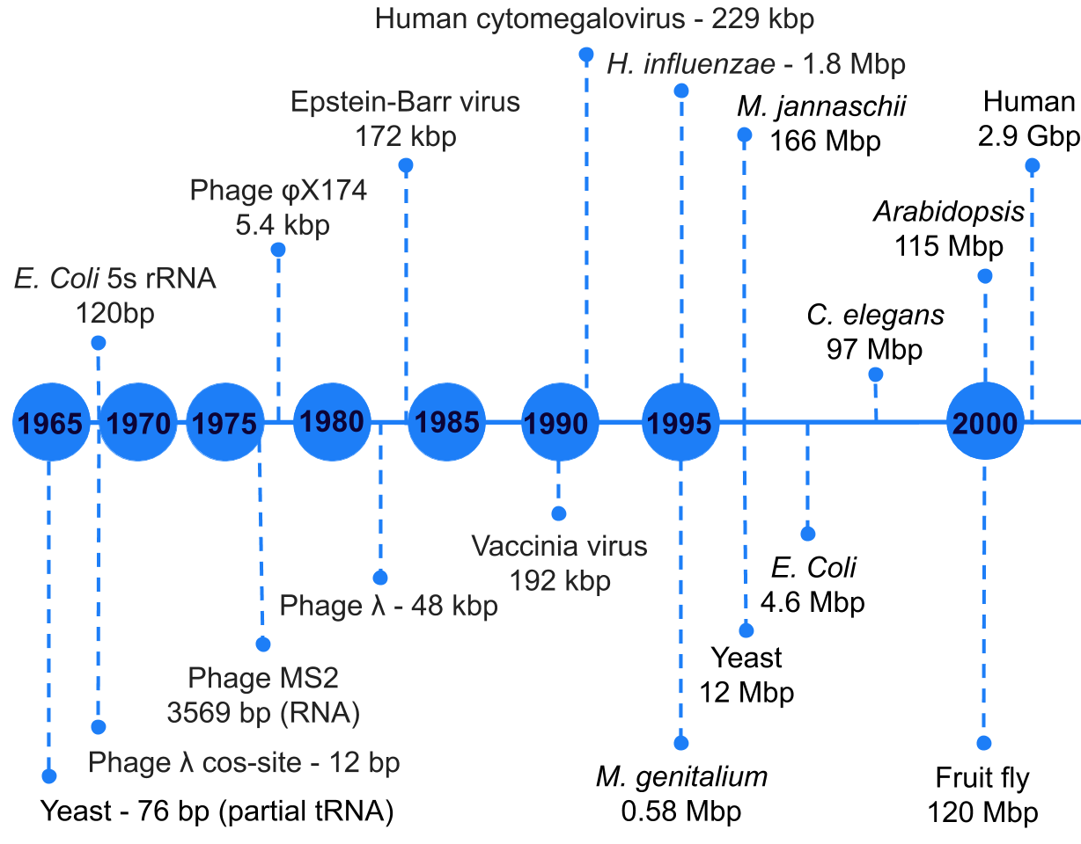
A trip back in time (1977-~2000) Sanger sequencing
What was the first genome to be sequenced?

Slide 5
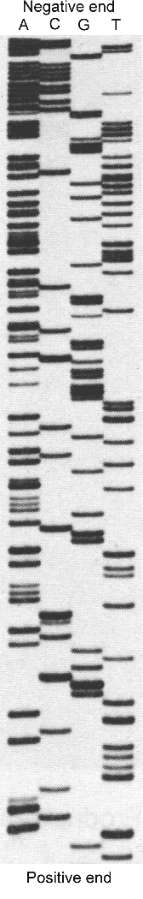
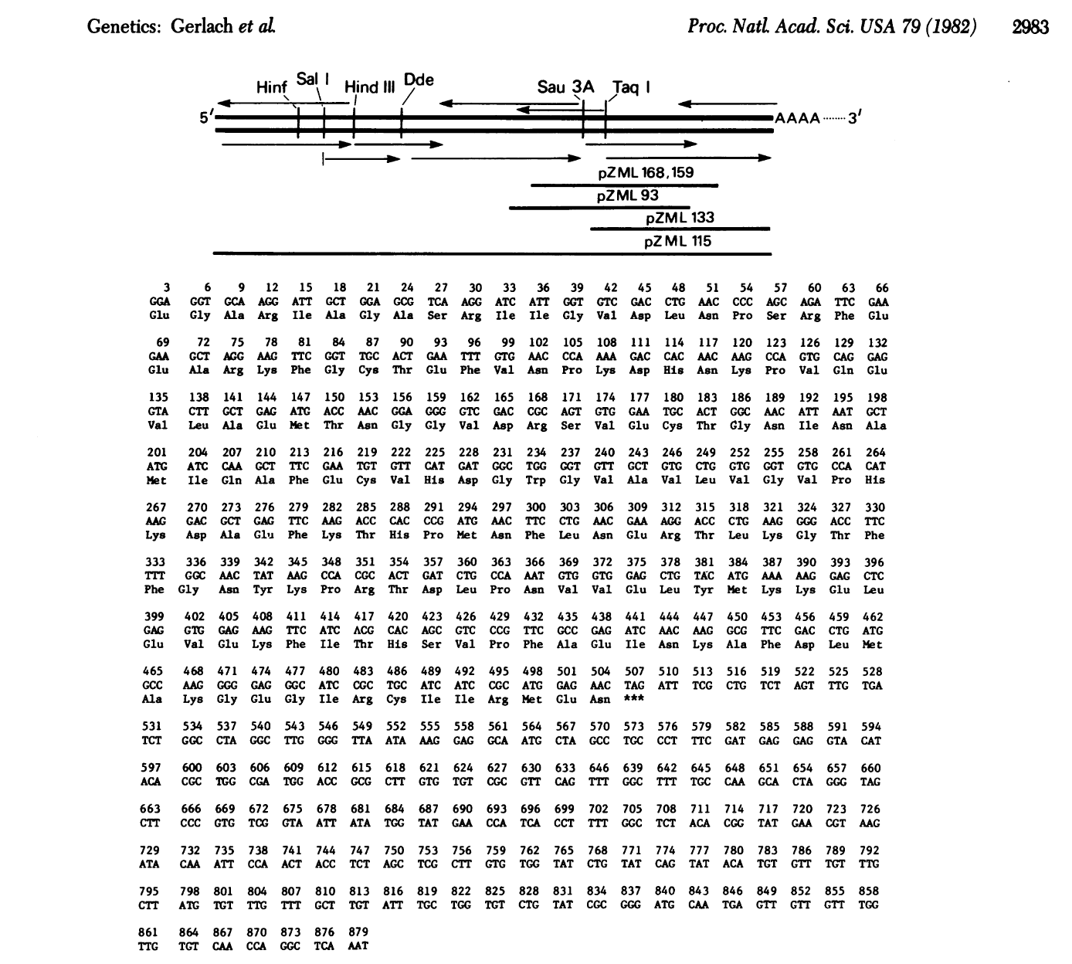
A trip back in time (1977-~2000) Sanger sequencing
Radiolabeled ddNTPs lacking the 3'-hydroxyl group, and terminate DNA synthesis when incorporated
4 separate PCRs, one for each radiolabeled nucleotide
Denature DNA, run on massive polyacrylamide gels
Manually determine sequence

Slide 6
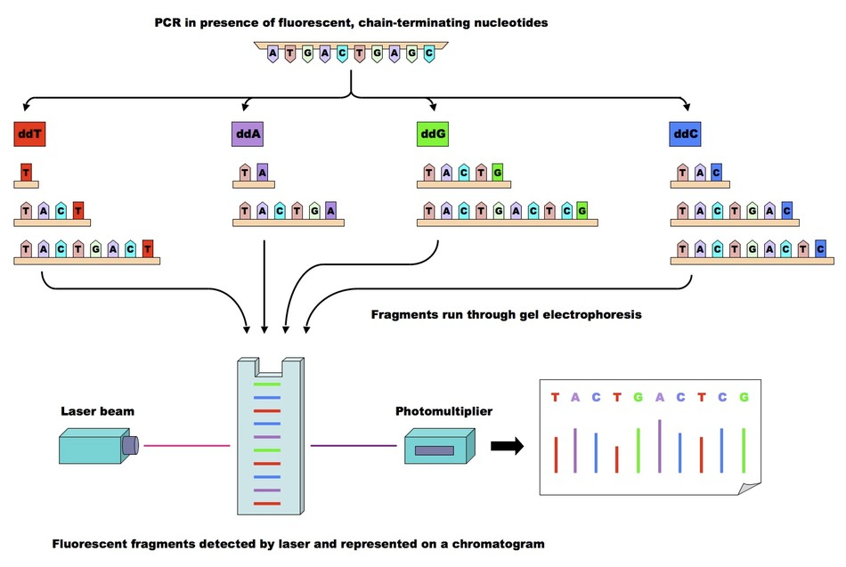
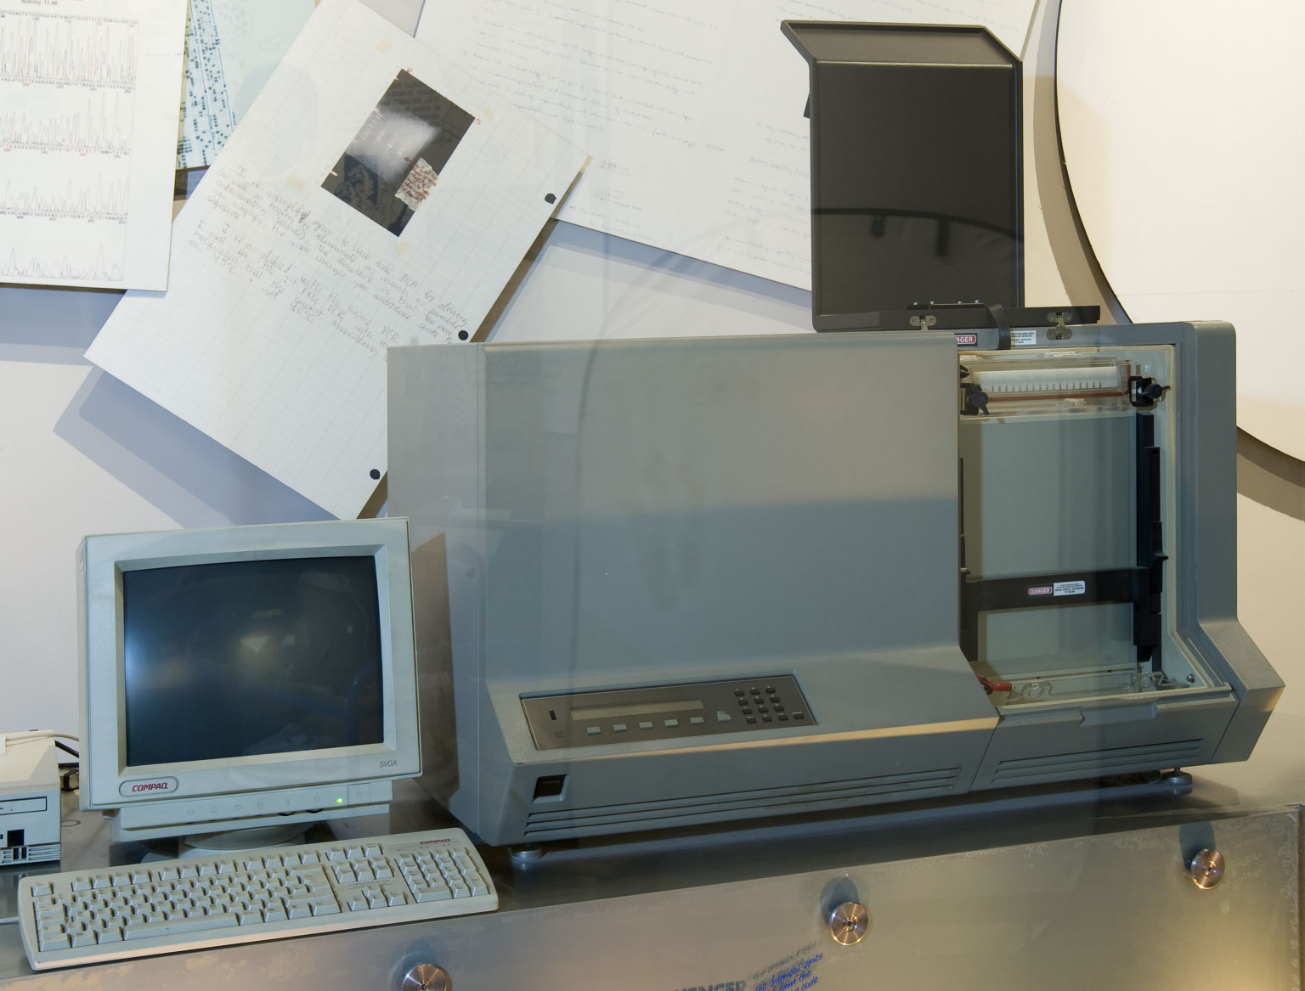
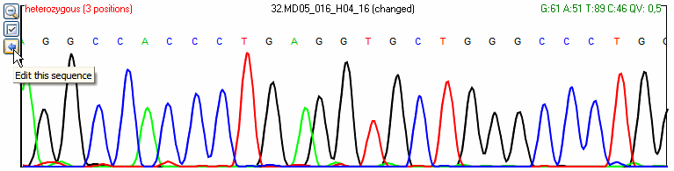
A trip back in time (1977-~2000) Sanger sequencing
Old ABI PRISM 377 sequences (~1990s)
Could sequence a single 900 bp read in 10-12 hours

Slide 7
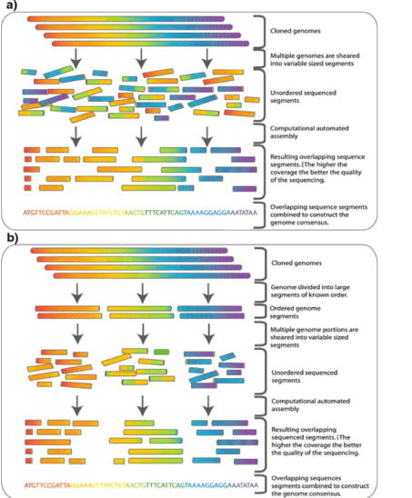
A trip back in time (1990s-2000s) How did we sequence big genomes?
Whole genome ‘shotgun’ sequencing
Map based sequencing
Isolate high molecular weight gDNA
Shear into large (100-200 kb) pieces
Map where pieces go
Sequence pieces individually
Assemble everything together
Isolate genomic DNA
Shear into small pieces
Sequence millions to billions of pieces/’reads’
Assemble
Computationally difficult
Repeats are hard to assemble
Might miss regions
Very accurate
MUCH more work

Slide 8
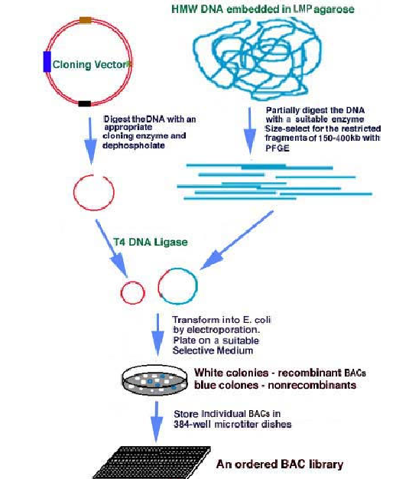
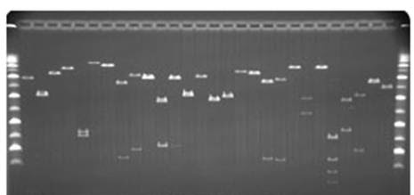
A trip back in time (1990s-2000s) BAC by BAC sequencing
Digest genomic DNA into 100-200kb pieces
Clone it into E. coli bacterial artificial chromosomes (BACs)
Transform and screen 5,000-50,000 colonies to build a BAC library
Each BAC is ~100-200 kb in length

Slide 9
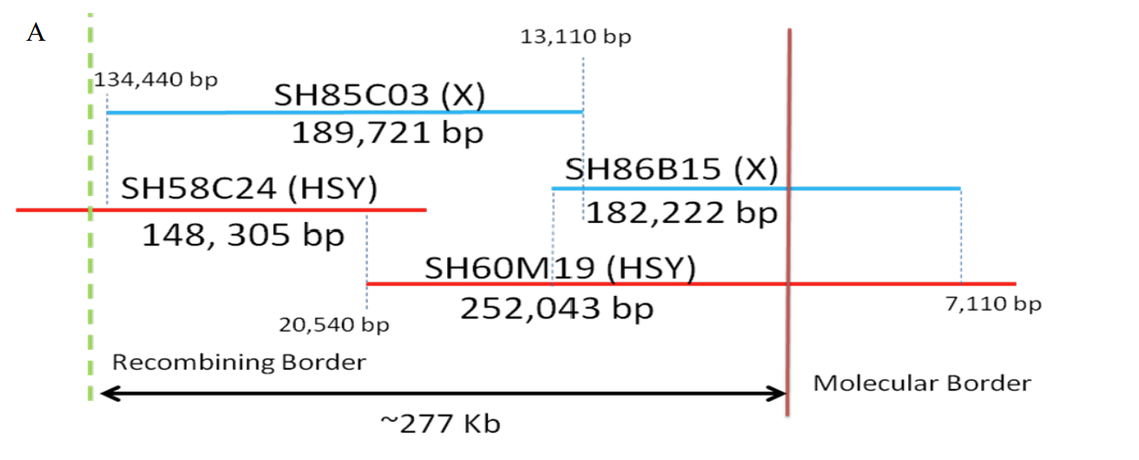
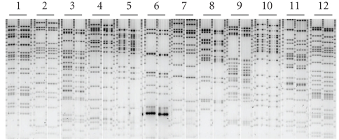
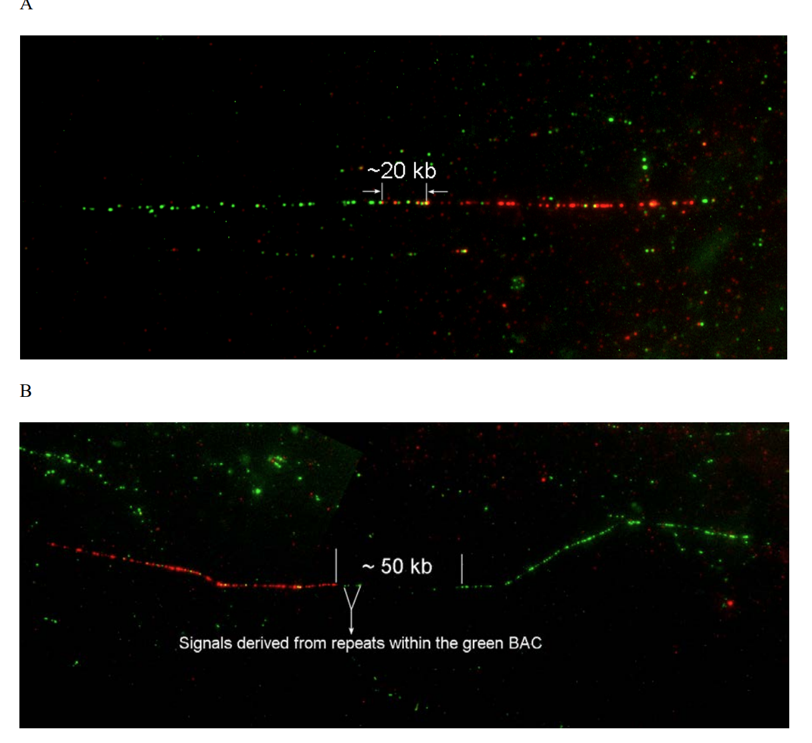
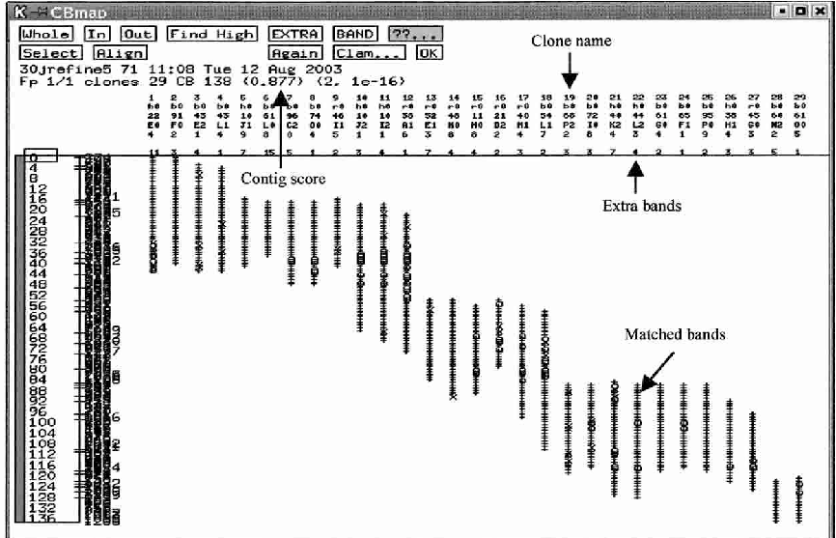
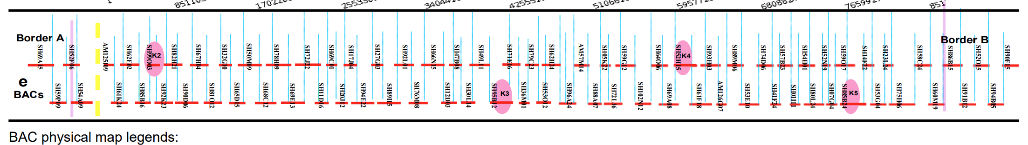
A trip back in time (1990s-2000s) BAC by BAC sequencing
‘Fingerprint’ each BAC, build a physical map of the BAC tiling path
Sequencing the papaya sex chromosomes (2004-2012), ~$20 million
Anchor ‘contigs’ from physical map to chromosomes in the genome, find gaps
Select the minimum tiling path for sequencing

Slide 10
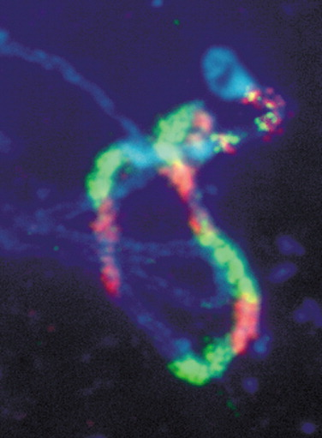
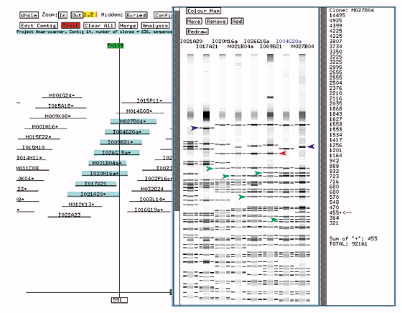
A trip back in time (1990s-2000s) BAC by BAC sequencing
Physical map of the Arabidopsis genome
Arabidopsis Pachytene Spread Probed by In Situ Hybridization with Each of 131 BACs from the Physical Map of Chromosome 4, Alternately Labeled in Red and Green

Slide 11
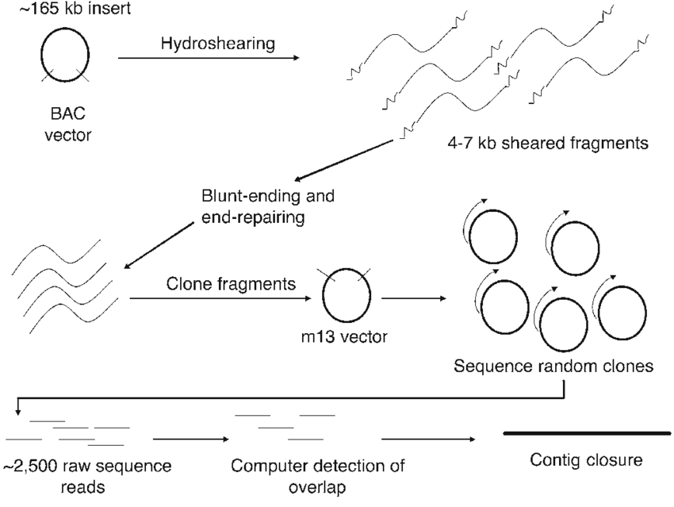
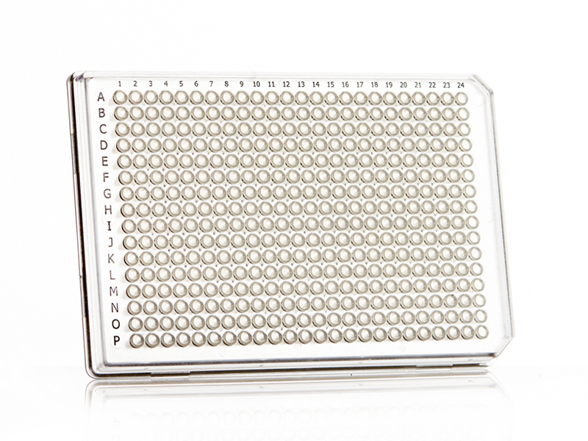
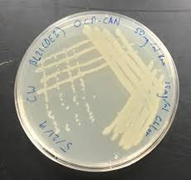
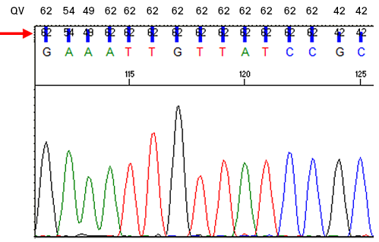
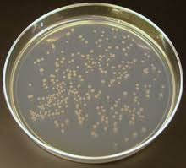
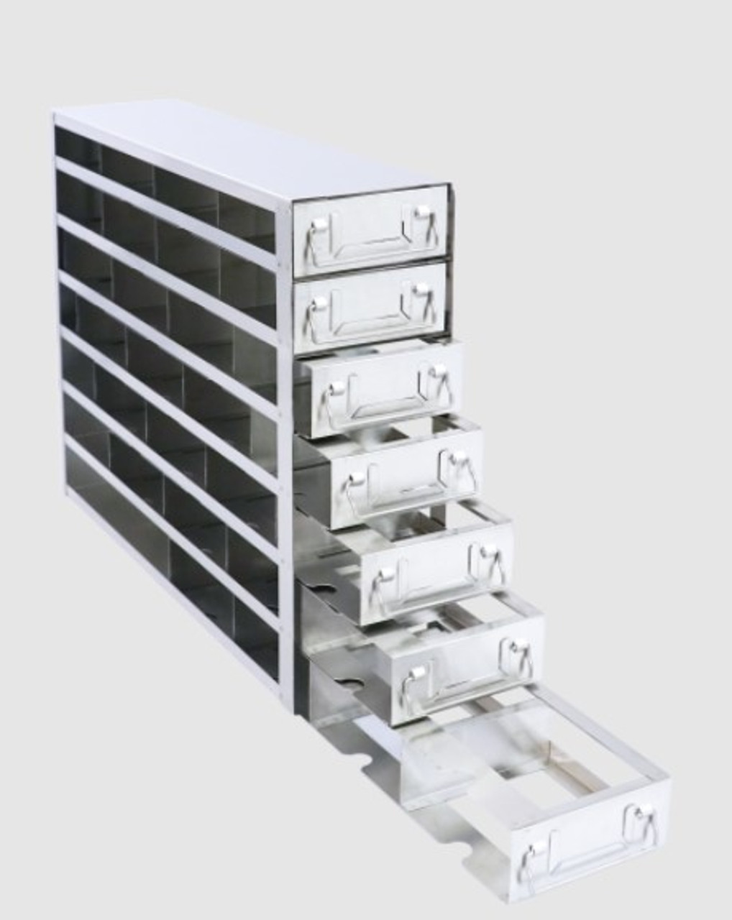
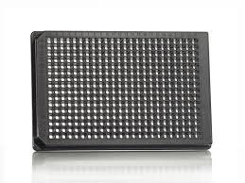
A trip back in time (1990s-2000s) BAC by BAC sequencing
Pick the right BAC! But don’t let everything thaw
Grow up, extract, and sequence 200-500 plasmids (e.g.,) colonies per BAC

Slide 12
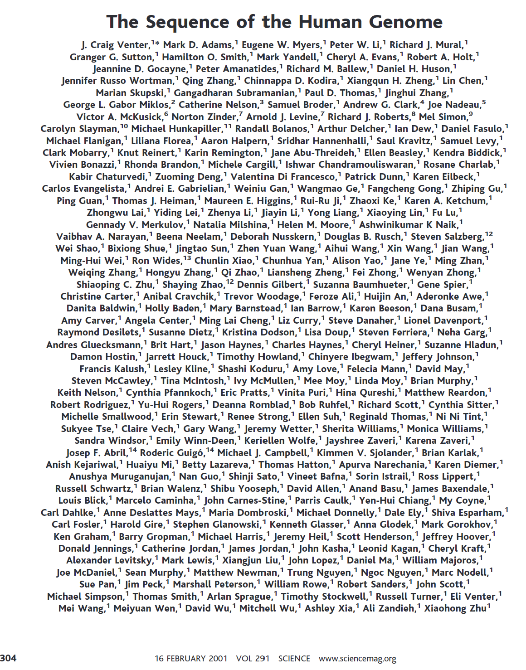
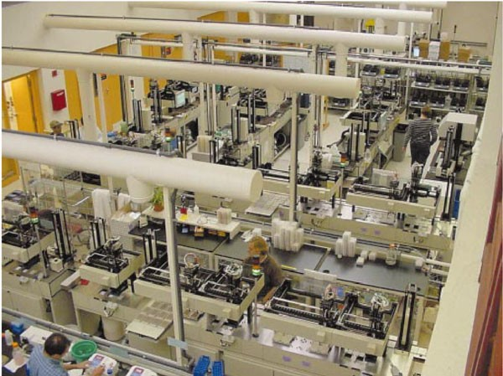


Sequencing the Human genome
The international Human Genome Project (HGP) used the hierarchical (BAC by BAC) shotgun approach
International effort, hundreds of Institutions
Celera Genomics adopted the whole-genome shotgun (WGS) approach

Slide 13
A trip back in time (1990s-2000s) BAC by BAC sequencing: How much did this all cost?
Human genome cost ~$3 billion (2001)
Arabidopsis genome cost ~$100 million (2001)
Rice genome cost ~$100 million (2006)

Slide 14
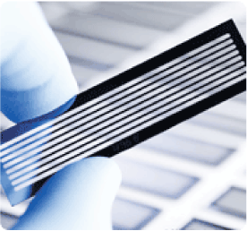
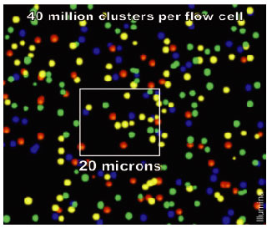
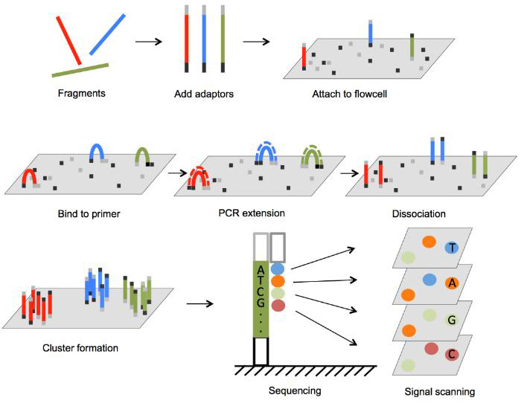
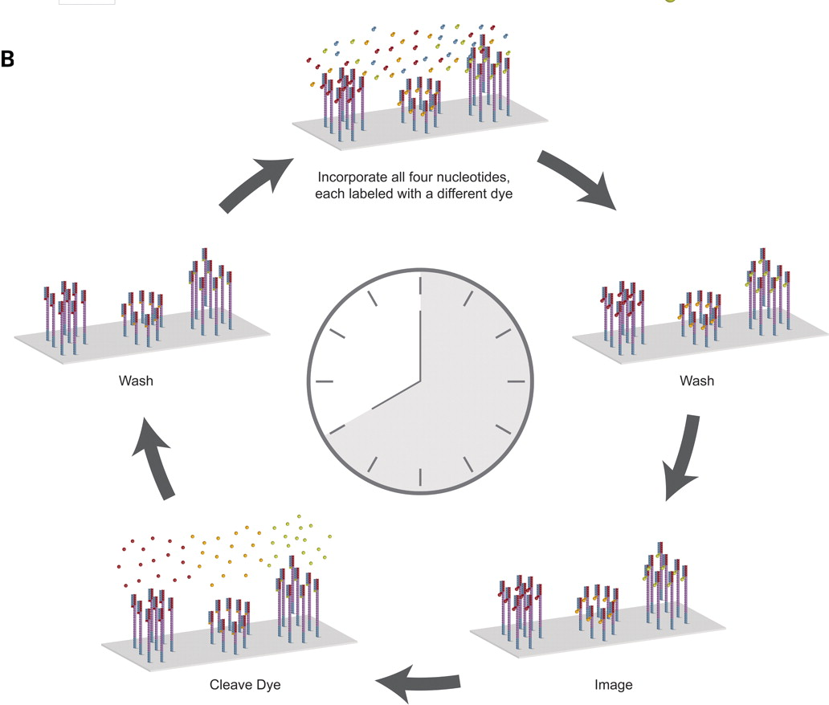
A trip back in time: (2008-present) Illumina sequencing
Sequence 1 bp at a time, image flow cell.
Identify each base foe each well
Wash flow cell, repeat 100-500 more times

Slide 15
A trip back in time: (2008-present) Illumina sequencing
Pros:
100-300bp reads
300-500 million reads/ flow cell
~600 Gb/ week
Low error rate
inexpensive
Cons:
Low coverage of GC regions
Short read length (cannot bridge repeats)

Slide 16
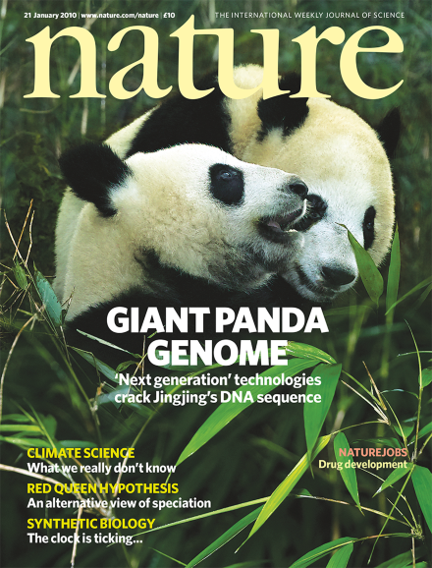
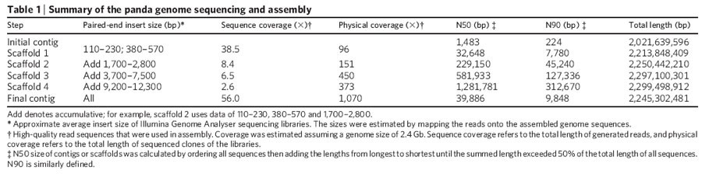
A trip back in time: (2008-present) Illumina sequencing
Illumina short reads (100-250 bp, paired end) came on the market in 2008, and radically shifted everything
The giant panda genome was the first to be assembled using just Illumina data, with libraries of different sizes and a new de bruin graph based algorithm that could handle the computational intensity of the new technology.
The assembly had a scaffold N50 of 40kb, with millions of contigs (fragments)
Much cheaper, but also MUCH lower quality

Slide 17
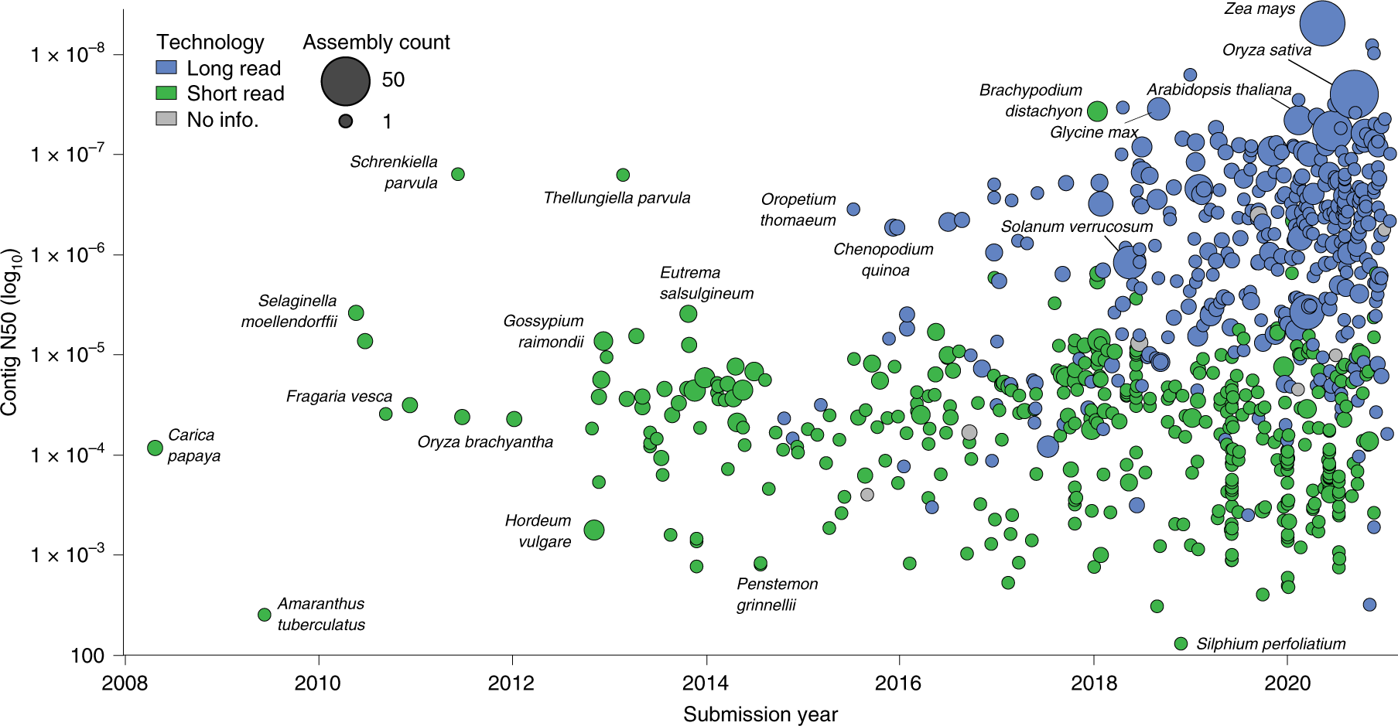
A trip back in time: (2008-present) Illumina sequencing
Plant genomes could now be sequenced for $10,000-$100,000, enabling hundreds to be completed
But they were very fragmented, and low quality

Slide 18
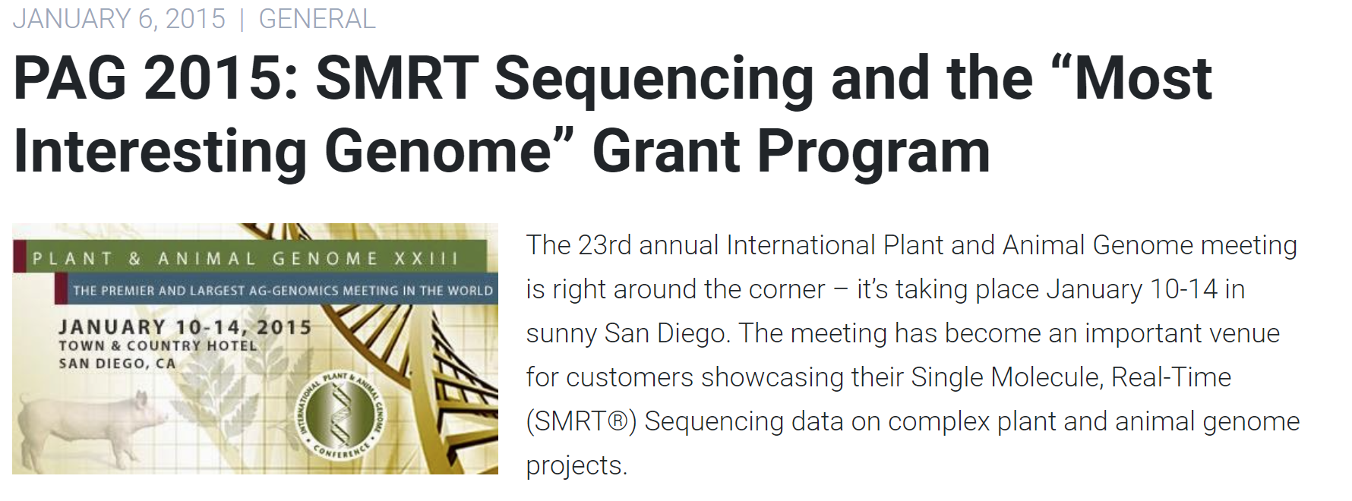
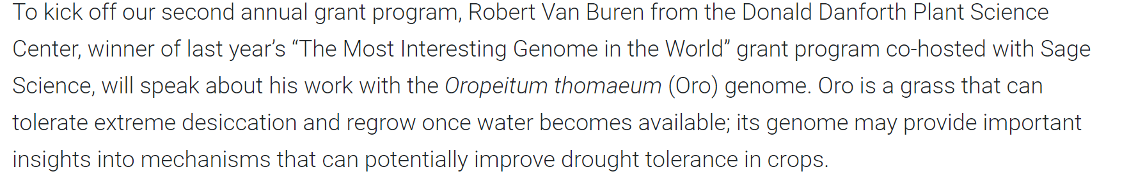
The present: third generation single molecule sequencing

Slide 19
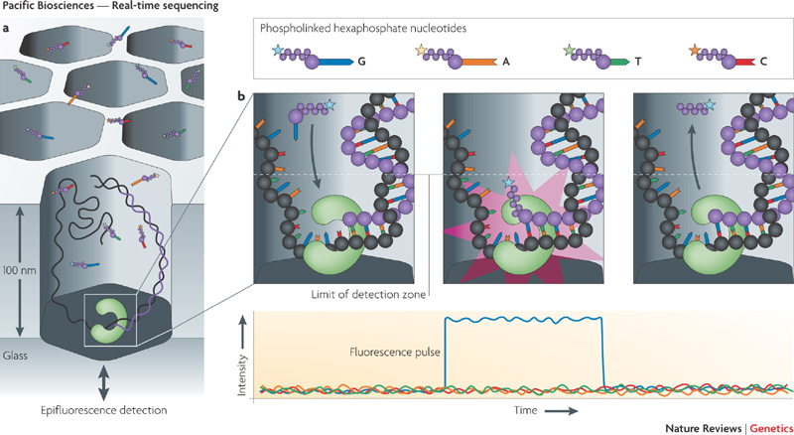
The present: third generation single molecule sequencing

Slide 20
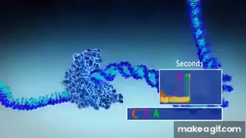
The present: third generation single molecule sequencing

Slide 21

The present: third generation single molecule sequencing
Thousands of wells in each microfluidics device, sequencing large fragments of DNA in real time

Slide 22
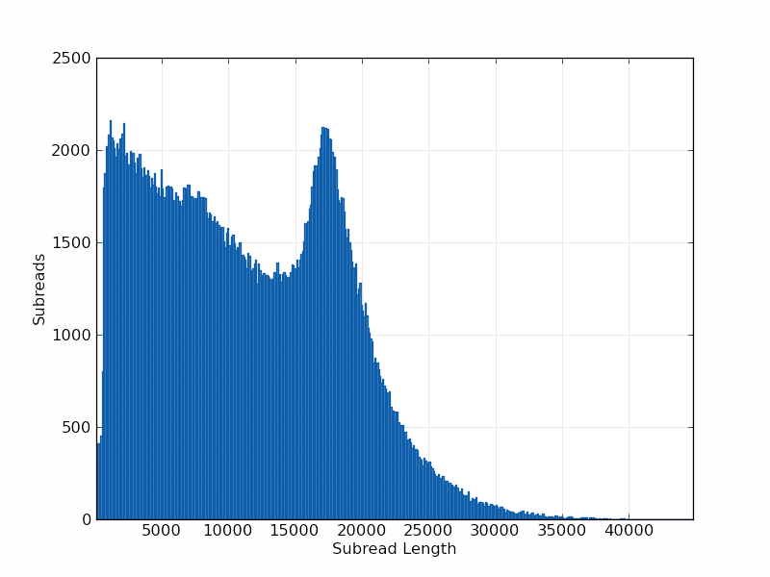
The present: third generation single molecule sequencing
Raw reads can be 10kb-500kb
Allows us to assemble through the most complex, challenging regions with ease

Slide 23
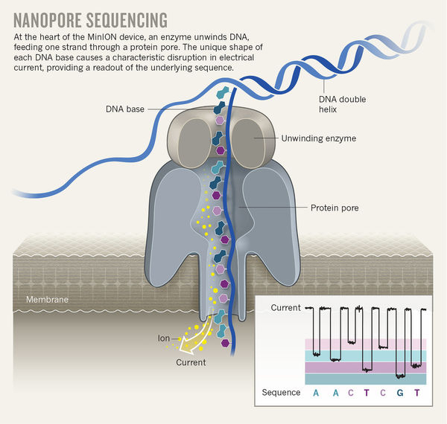
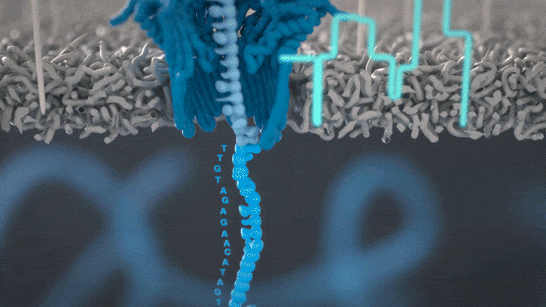
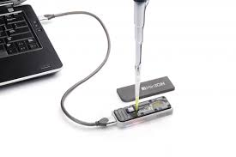
The present: third generation single molecule sequencing

Slide 24
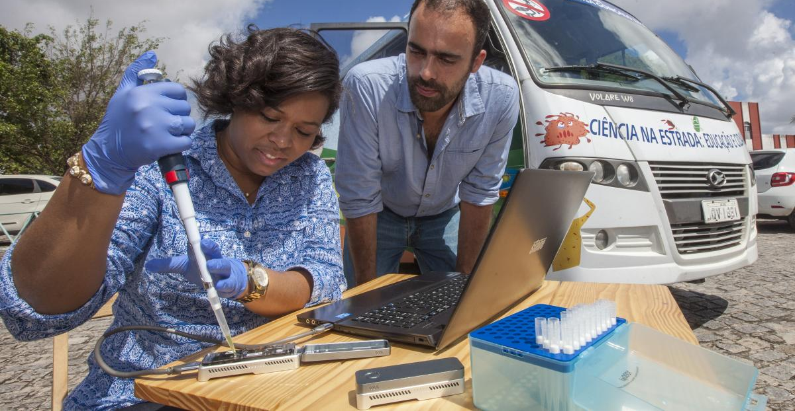
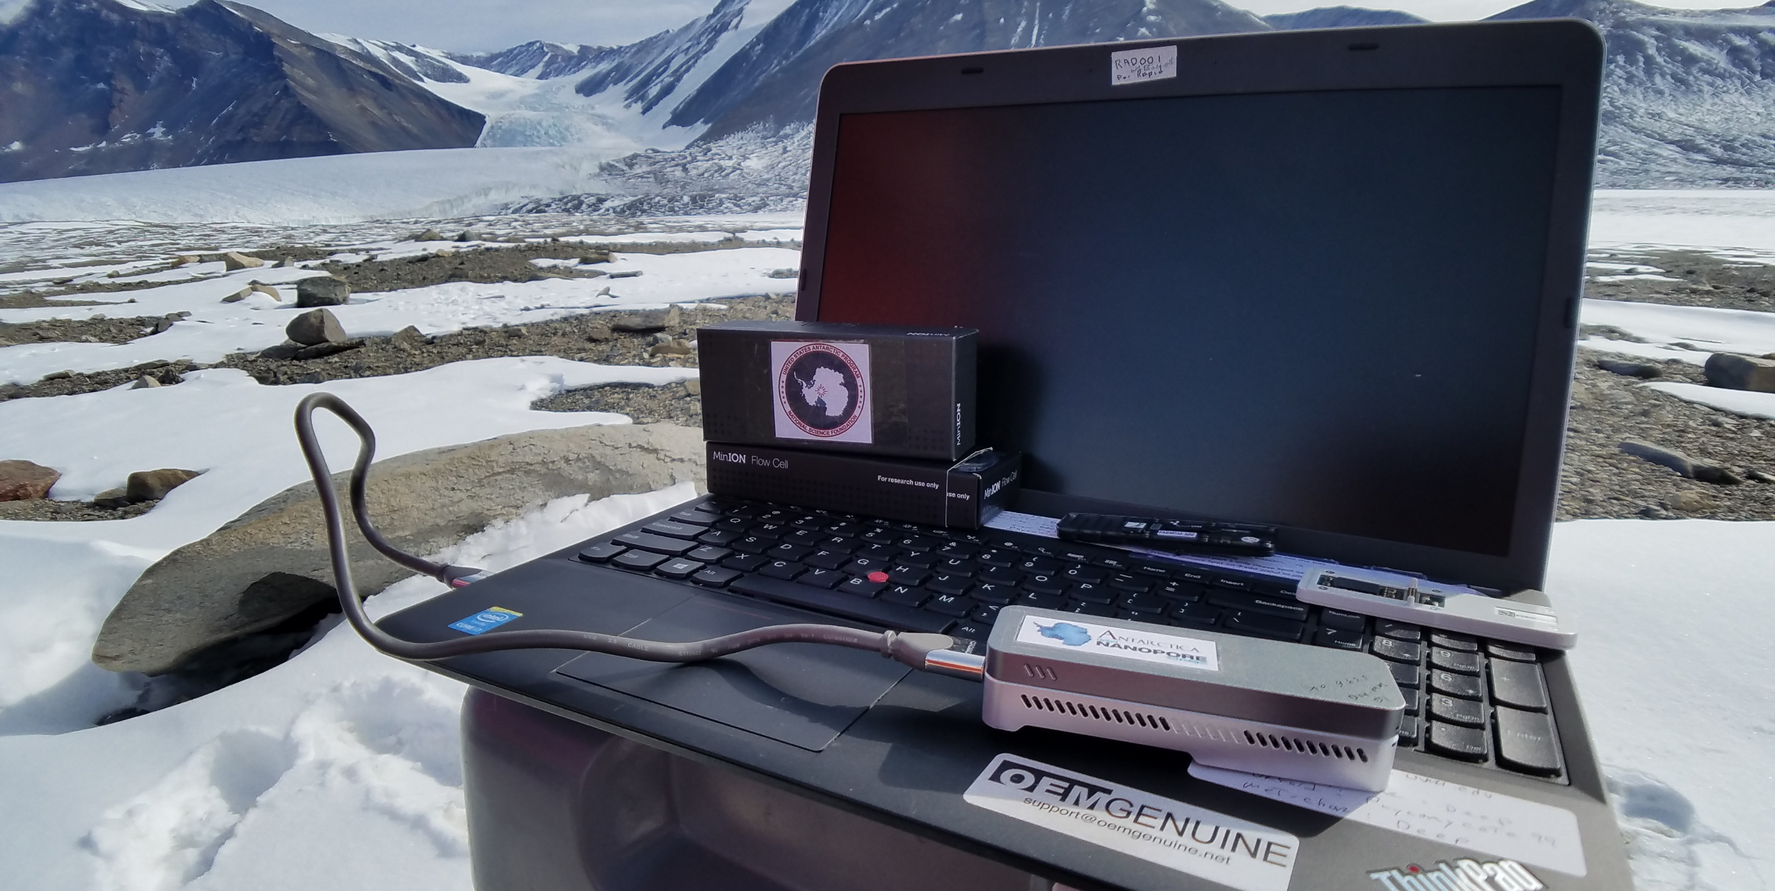
The present: third generation single molecule sequencing
Long reads (10kb-500kb)
But, reads are highly error prone (only 90-95% accurate)
Presents challenges during genome assembly, and another technology needs to be used for genome ‘polishing’ to remove residual errors

Slide 25
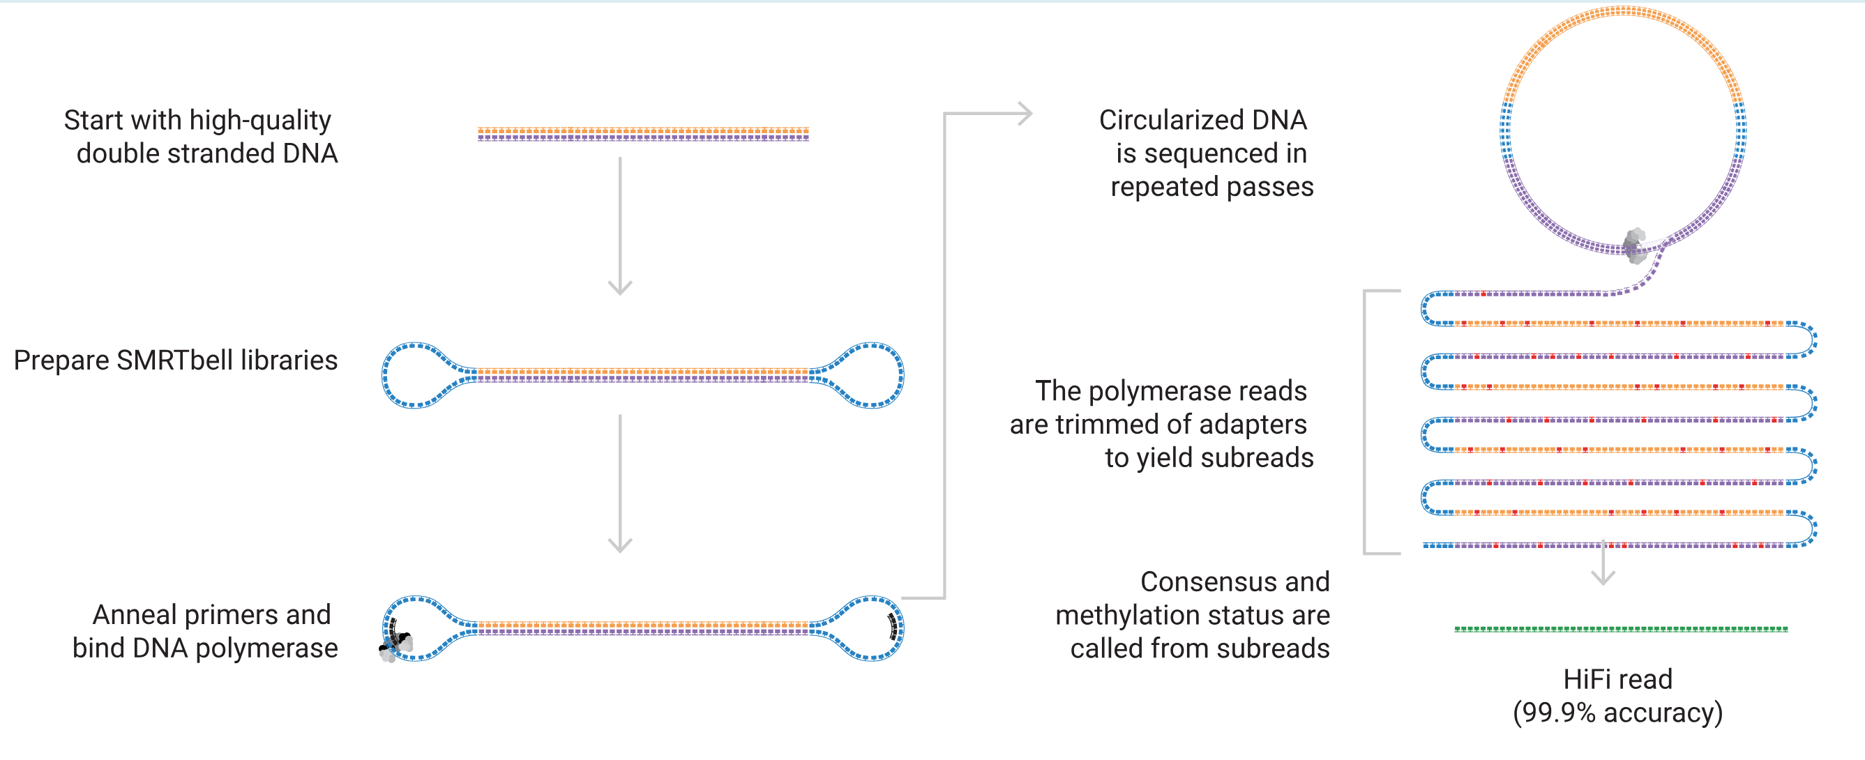
The present: PacBio HiFi sequencing

Slide 26
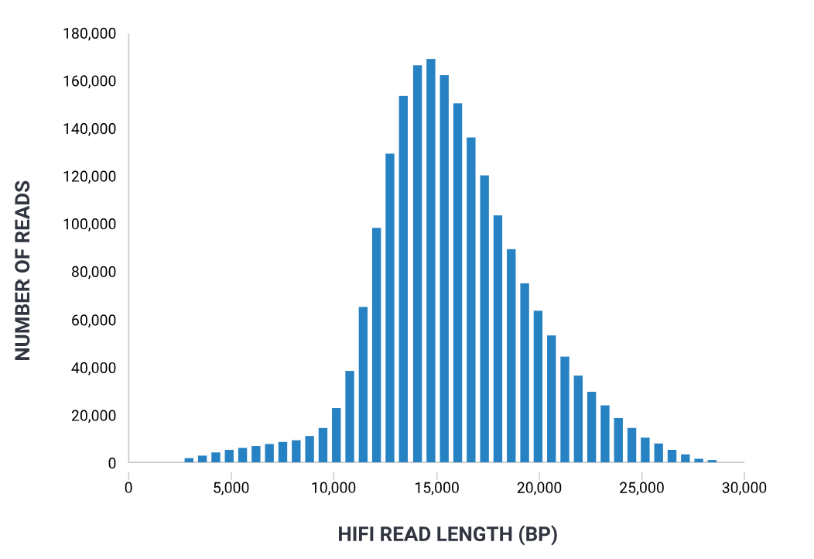
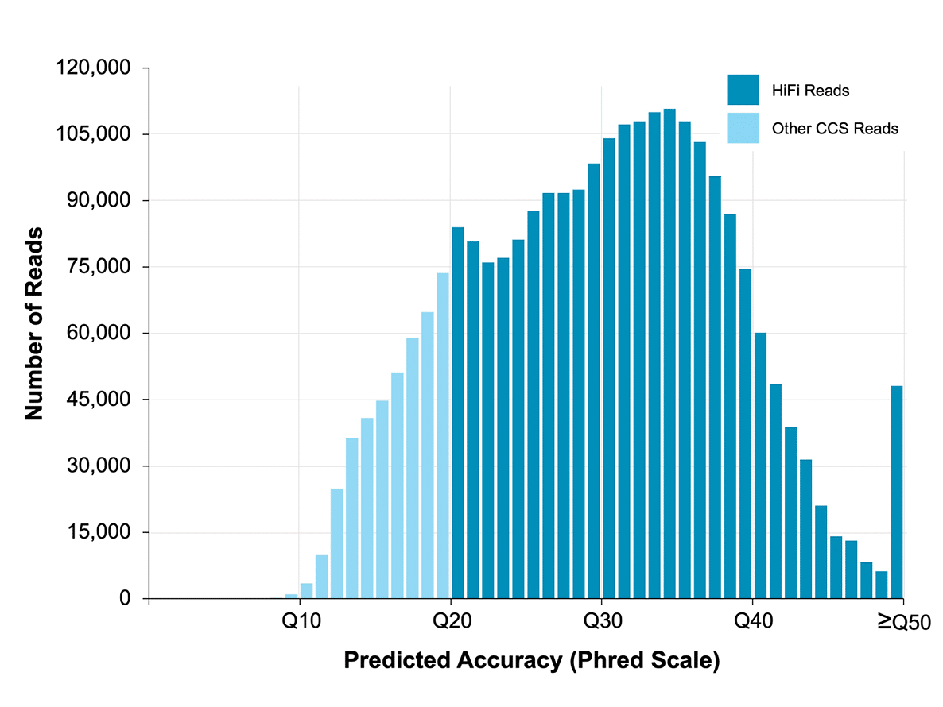
The present: PacBio HiFi sequencing
HiFi reads have an average Phred score of Q30, or 1 error in 1000 (99.9% accuracy).
In comparison, raw PacBio reads have 5-10% errors.
HiFi reads have an average length of ~15-20 kb, depending on library prep/input quality. Each ‘raw’ read is ~50-100kb, with 3-10 passes around the circle.

Slide 27
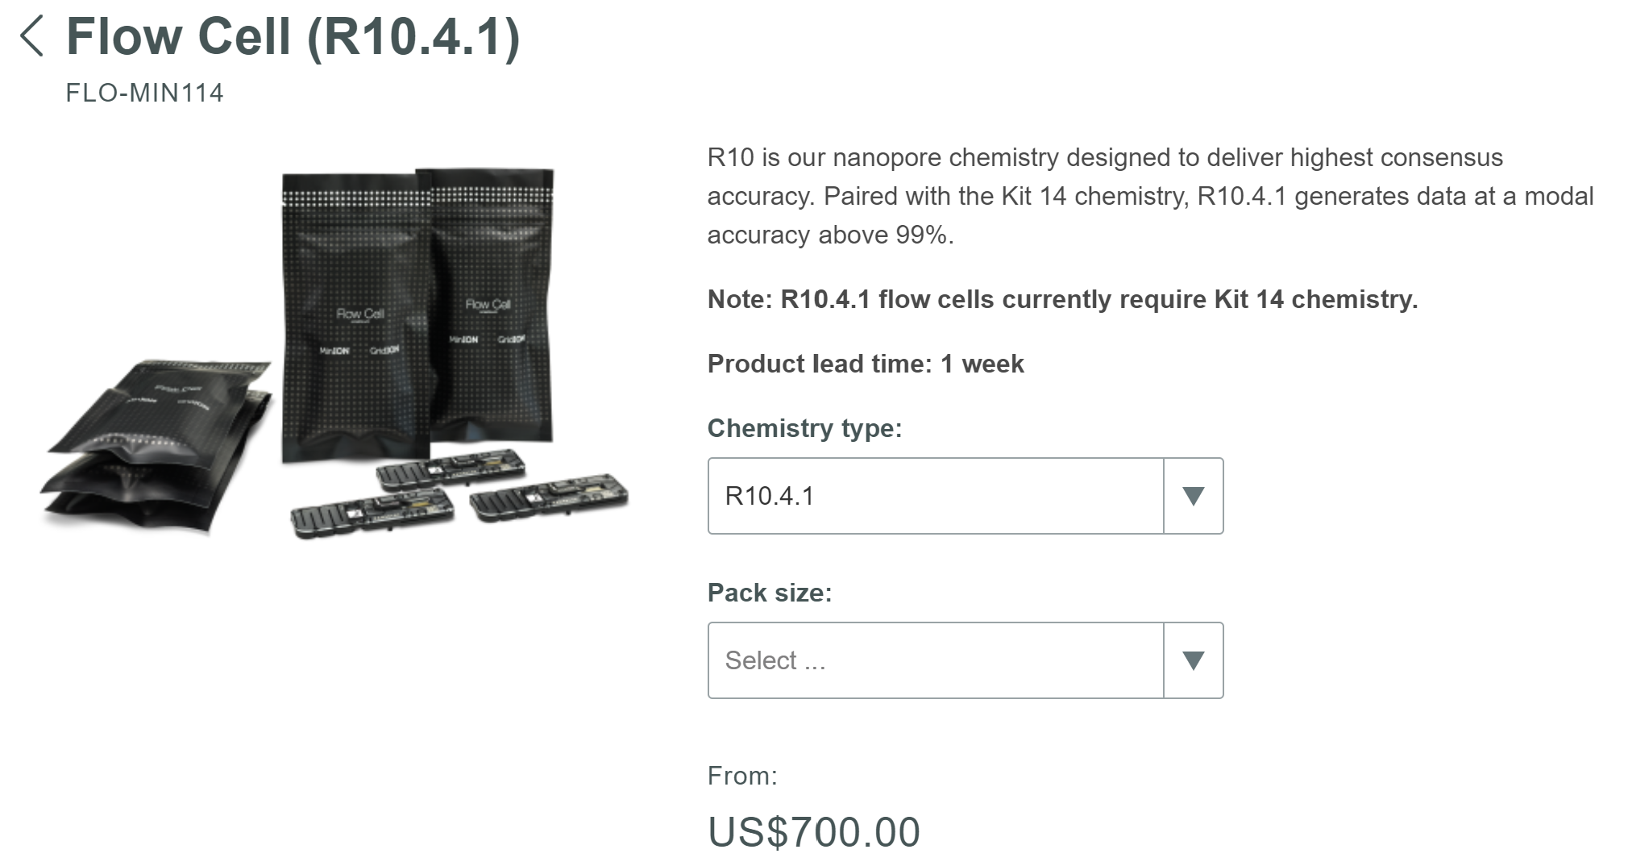
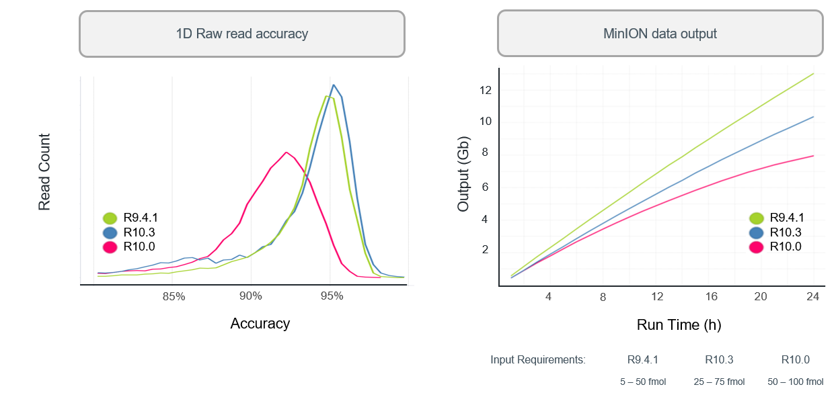
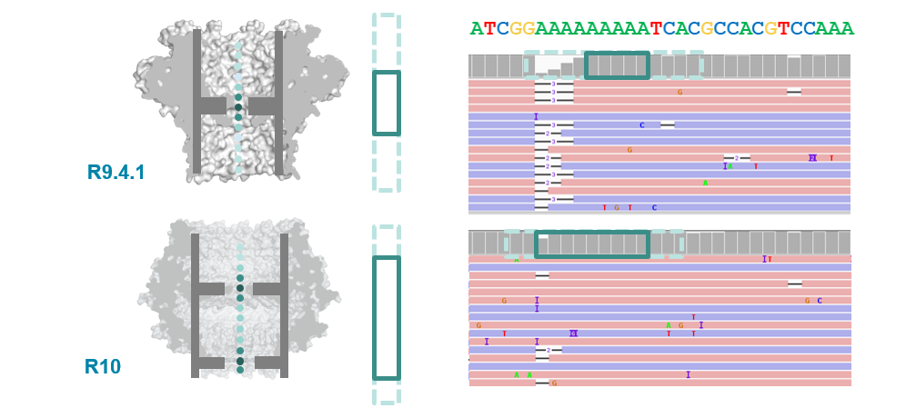
The present: Nanopore v10
R10 flow cells pass two detectors, enabling much higher raw read quality

Slide 28

Complete, telomere to telomere genomes
The maize genome is essentially complete now, no gaps!
The new gold standard is telomere to telomere genomes (e.g., no gaps or mistakes)

Slide 29

Complete, telomere to telomere genomes
Current workflow for generating complete (gap free) reference genomes
Isolate high molecular weight genomic DNA
Generate high-quality long read sequences
(25-50x) PacBio HiFi or Nanopore V10+
Optional: Generate complementary Long range scaffolding data using HiC or optical mapping
Assembly and validate
Optional: haplotype phasing
Next step:
Annotation How do we identify genes and other genome elements?

Slide 30

We know how to sequence things, how do we put them together?

Slide 31

Genome assembly: Hifiasm
Graph Cleaning and Simplification: Hifiasm utilizes a sophisticated graph cleaning process to remove errors and ambiguities from the initial graph built from HiFi reads, simplifying complex regions and enhancing the accuracy of the assembly.
Ultra-long Reads Utilization: It effectively leverages PacBio HiFi reads, known for their high accuracy and length, to construct highly contiguous and accurate genome assemblies, minimizing gaps and resolving repetitive sequences.
Phased Assembly: The assembler supports the generation of phased genome assemblies, distinguishing between haplotypes in diploid organisms to capture genetic diversity and structural variations more accurately.
Adaptive Overlapping: Hifiasm dynamically adjusts its algorithms to optimize overlap detection based on the input data quality and complexity, ensuring robust assembly across various genomes and conditions.

Slide 32


Running HiFiasm on HPCC: Wednesday’s class

Slide 33

Looking forward

